Slide 1
Software Engineering
Lecture 3

Slide 2
What is modeling?
Modeling consists of building an abstraction of reality.
Abstractions are simplifications because:
They ignore irrelevant details and
They only represent the relevant details.
What is relevant or irrelevant depends on the purpose of the model.

Slide 3
Why model software?
Why model software?
Software is getting increasingly more complex
Windows XP > 40 mio lines of code
A single programmer cannot manage this amount of code in its entirety.
Code is not easily understandable by developers who did not write it
We need simpler representations for complex systems
Modeling is a mean for dealing with complexity

Slide 4
Systems, Models and Views
A model is an abstraction describing a subset of a system
A view depicts selected aspects of a model
A notation is a set of graphical or textual rules for depicting views
Views and models of a single system may overlap each other
Examples:
System: Aircraft
Models: Flight simulator, scale model
Views: All blueprints, electrical wiring, fuel system

Slide 5
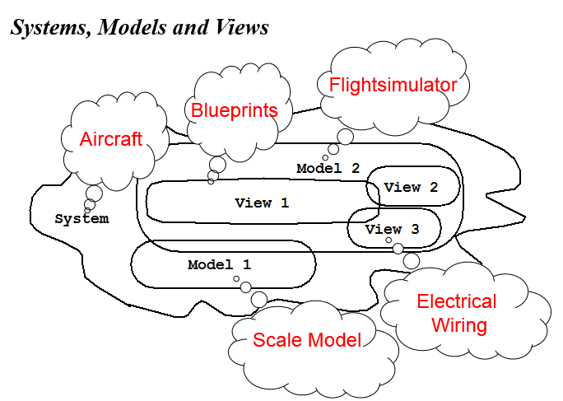

Slide 6
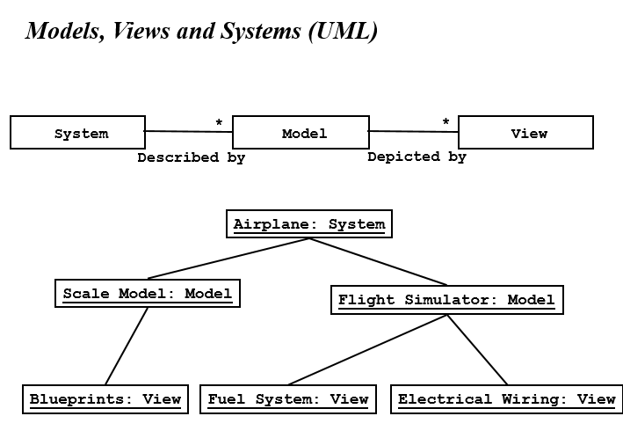

Slide 7
What is UML?
UML (Unified Modeling Language)
An emerging standard for modeling object-oriented software.
Resulted from the convergence of notations from three leading object-oriented methods:
OMT (James Rumbaugh)
OOSE (Ivar Jacobson)
Booch (Grady Booch)
Reference: “The Unified Modeling Language User Guide”, Addison Wesley, 1999.
Supported by several CASE tools
Rational ROSE
TogetherJ

Slide 8
Types of UML Diagrams:
Use case Diagrams
Describe the functional behavior of the system as seen by the user.
Class diagrams
Describe the static structure of the system: Objects, Attributes, Associations
Sequence diagrams
Describe the dynamic behavior between actors and the system and between objects of the system
Statechart diagrams
Describe the dynamic behavior of an individual object (essentially a finite state automaton)
Activity Diagrams
Model the dynamic behavior of a system, in particular the workflow (essentially a flowchart)

Slide 9
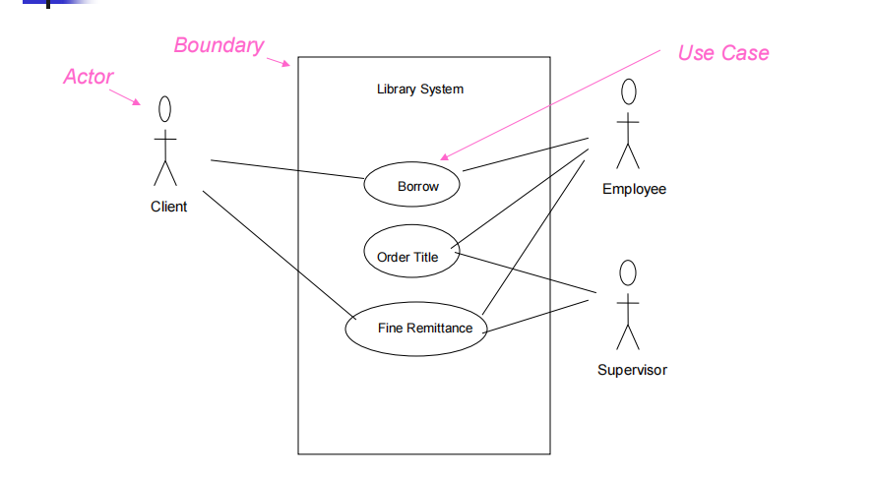

Slide 10
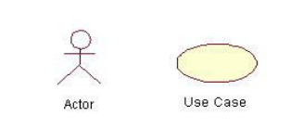
Use-Case Diagrams
Actors: A role that a user plays with respect to the system, including human
users and other systems. e.g., inanimate physical objects (e.g. robot); an
external system that needs some information from the current system.
Use case: A set of scenarios that describing an interaction between a user
and a system, including alternatives.
System boundary: rectangle diagram representing the boundary between
the actors and the system.

Slide 11
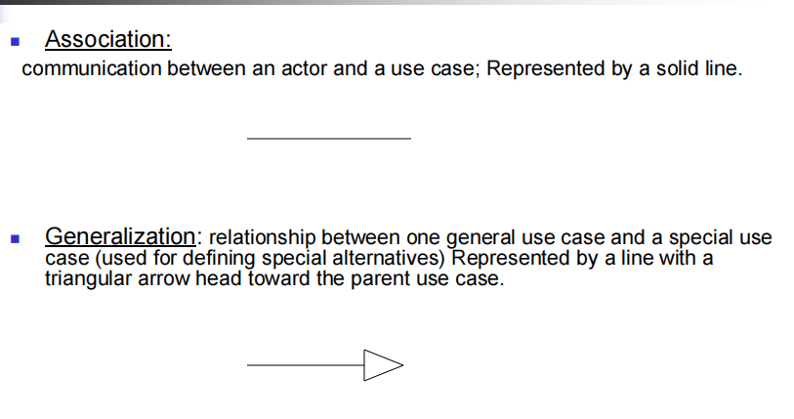

Slide 13
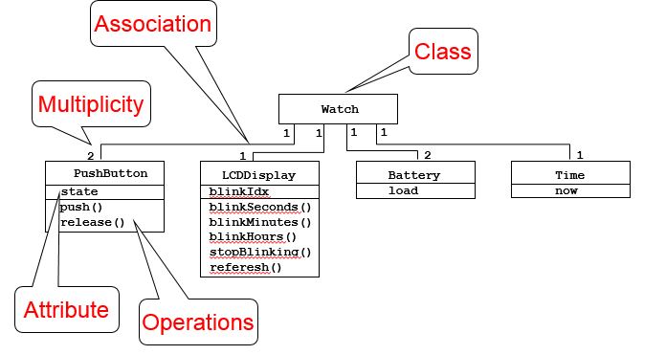
UML first pass: Class diagrams
Class diagrams represent the structure of the system

Slide 14
